Slide 1
Dog Behavioral Monitoring System
Final Presentation
2020-045

Slide 2
Research Group Details
Group ID: 2020-045
Supervisor: Dr. Pradeepa Samarasinghe
Co Supervisor: Ms. Lokesha Weerasinghe
External Supervisor: Dr. A Sugantha
Member of Veterinary Council
of Sri Lanka
National Hospital Of Colombo
Student Name | Registration Number
Herath H.M.K. S | IT16175426
Peiris M.D.P | IT17123150
Boteju W.J.M (Leader) | IT17133678
A.K.P Erandi Wathsala | IT17141352

Slide 3

Introduction
Developing a Mobile Application which tracks and monitors the behaviour of our Pet Dogs.
This application will track the Unusual behavioural changes and notify the user.

Slide 4
Research Problem Definition
Dogs may undergo different health conditions which are not noticed by their owners.
Differences in the behaviors such as resting, walking, barking behaviour of the pet dog based on breed and age should be noticed by the owners in order to identify their unusual behaviors.

Slide 5
Proof of Concept
A dog behavior tracking system is implemented using both image processing and machine learning concepts.
The following are analyzed in this research study.
Breed recognition.
Walking behavioural changes based on the dog’s identified breed and age.
Resting behavioural changes based on the dog’s identified breed and age.
Barking behavioural patterns.

Slide 6
Research Solution
Dog behavior can be differentiated according to its Breed and Age.
Dog breed identification using a CNN model and transfer learning can be taken to identify behavioral patterns of the dog according to the breed and age.
Resting patterns of a dog which can vary with the breed is measured using image processing and if any unusual sleeping pattern is observed, the owner is notified.
Walking Patterns of a dog for a day will be observed using a sensor. The walking patterns of a dog with a different health condition may show a slight change in his walking and running patterns.
Barking behavior identification using audio analyzing under different situations. Barking behavior can be different for several reasons.

Slide 7
Dog Breed Identification
IT16175426
H.M.K.S Herath

Slide 8
Research Problem Definition
How to use dog breed identification to track unusual behaviors of a specific dog breed ?

Slide 9
Proof of Concept
Ability to identify the pet dog breed in the video or image using image processing
Ability to specify the special characteristics according to the dog breed as a help to identify the pet dog’s unusual behaviors for the walking and resting behavior analyzing components.

Slide 10
Application of key pillars in specialized area.
Application of the pre-trained ResNet101 architecture on imagenet dataset to identify the animal in the video or image as a dog and extend the model to identify the dog breed using transfer learning.
Store Resting hours and Activity levels according to the breeds in the database.
Creating an API to handle the communication among the model, database and other components which requires data regarding resting time and the activity levels of the dogs.

Slide 11
Application of technologies in the relevant key pillar / area.
Utilizing Python language to train the model for identifying the breed of the pet dog. Python provides extensive set of libraries for machine learning. (torch, torchvision)
DJANGO framework (Python) to create the API.
Flutter Application for the implementation of the front end.
MongoDB as the database.

Slide 12
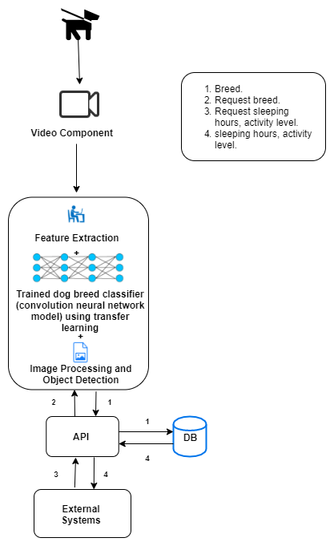

Slide 13
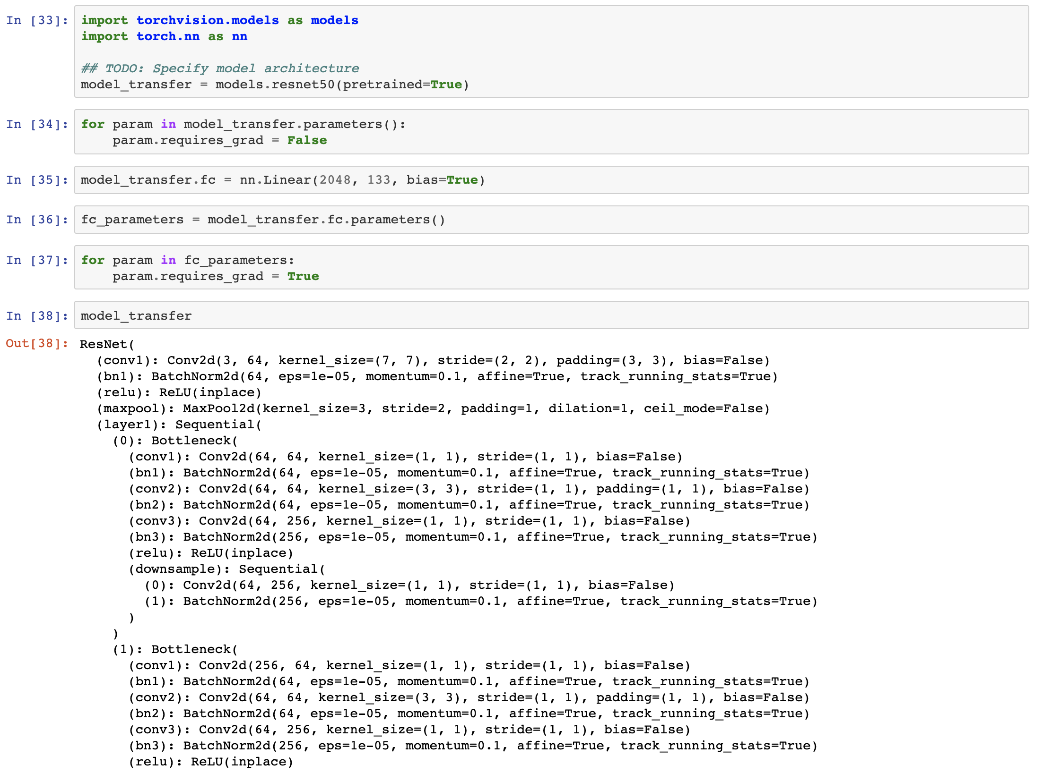
Completion of Prototype.
Implementation of a model for dog breed recognition
Specifying model architecture using ResNet101.

Slide 14
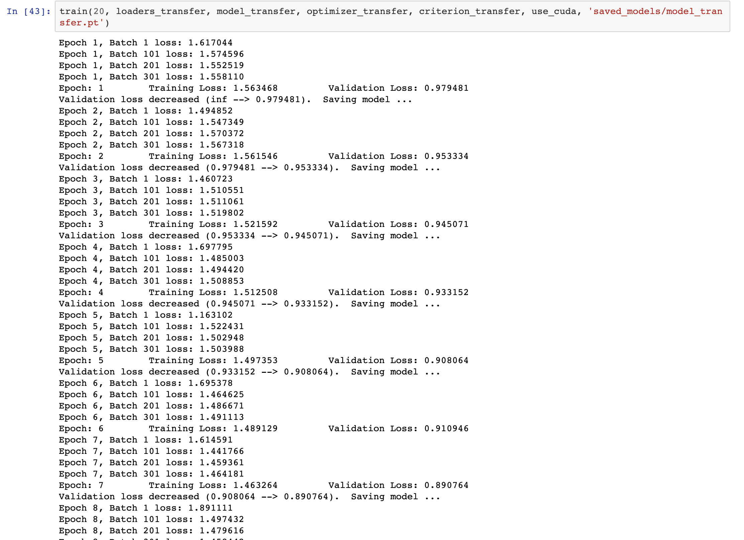
Training and validating the model

Slide 15
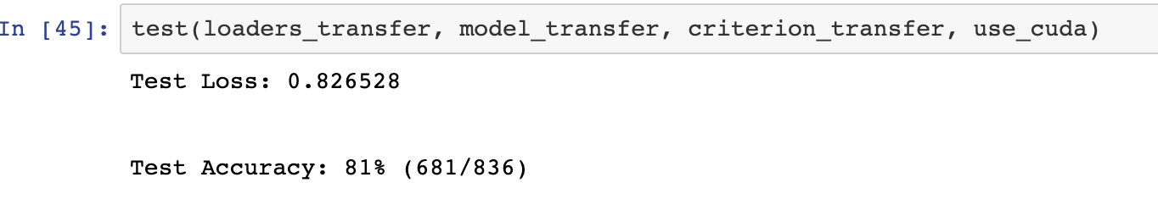
Testing the model

Slide 16
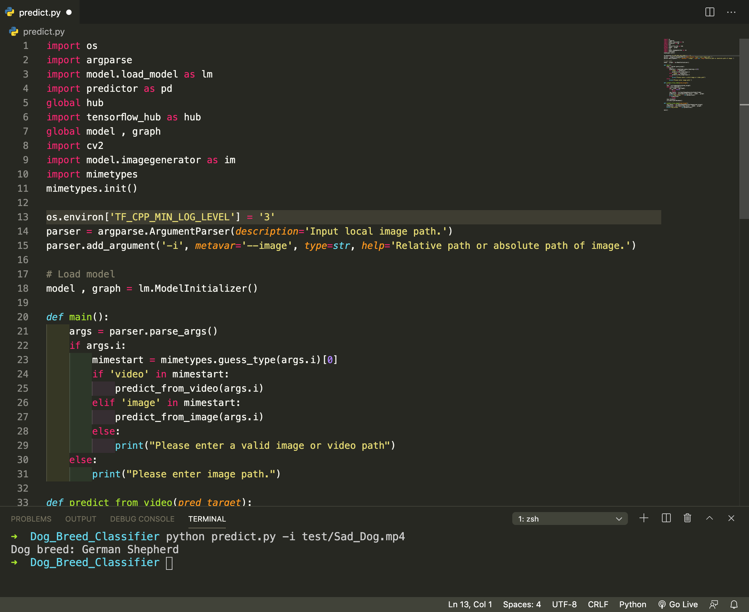
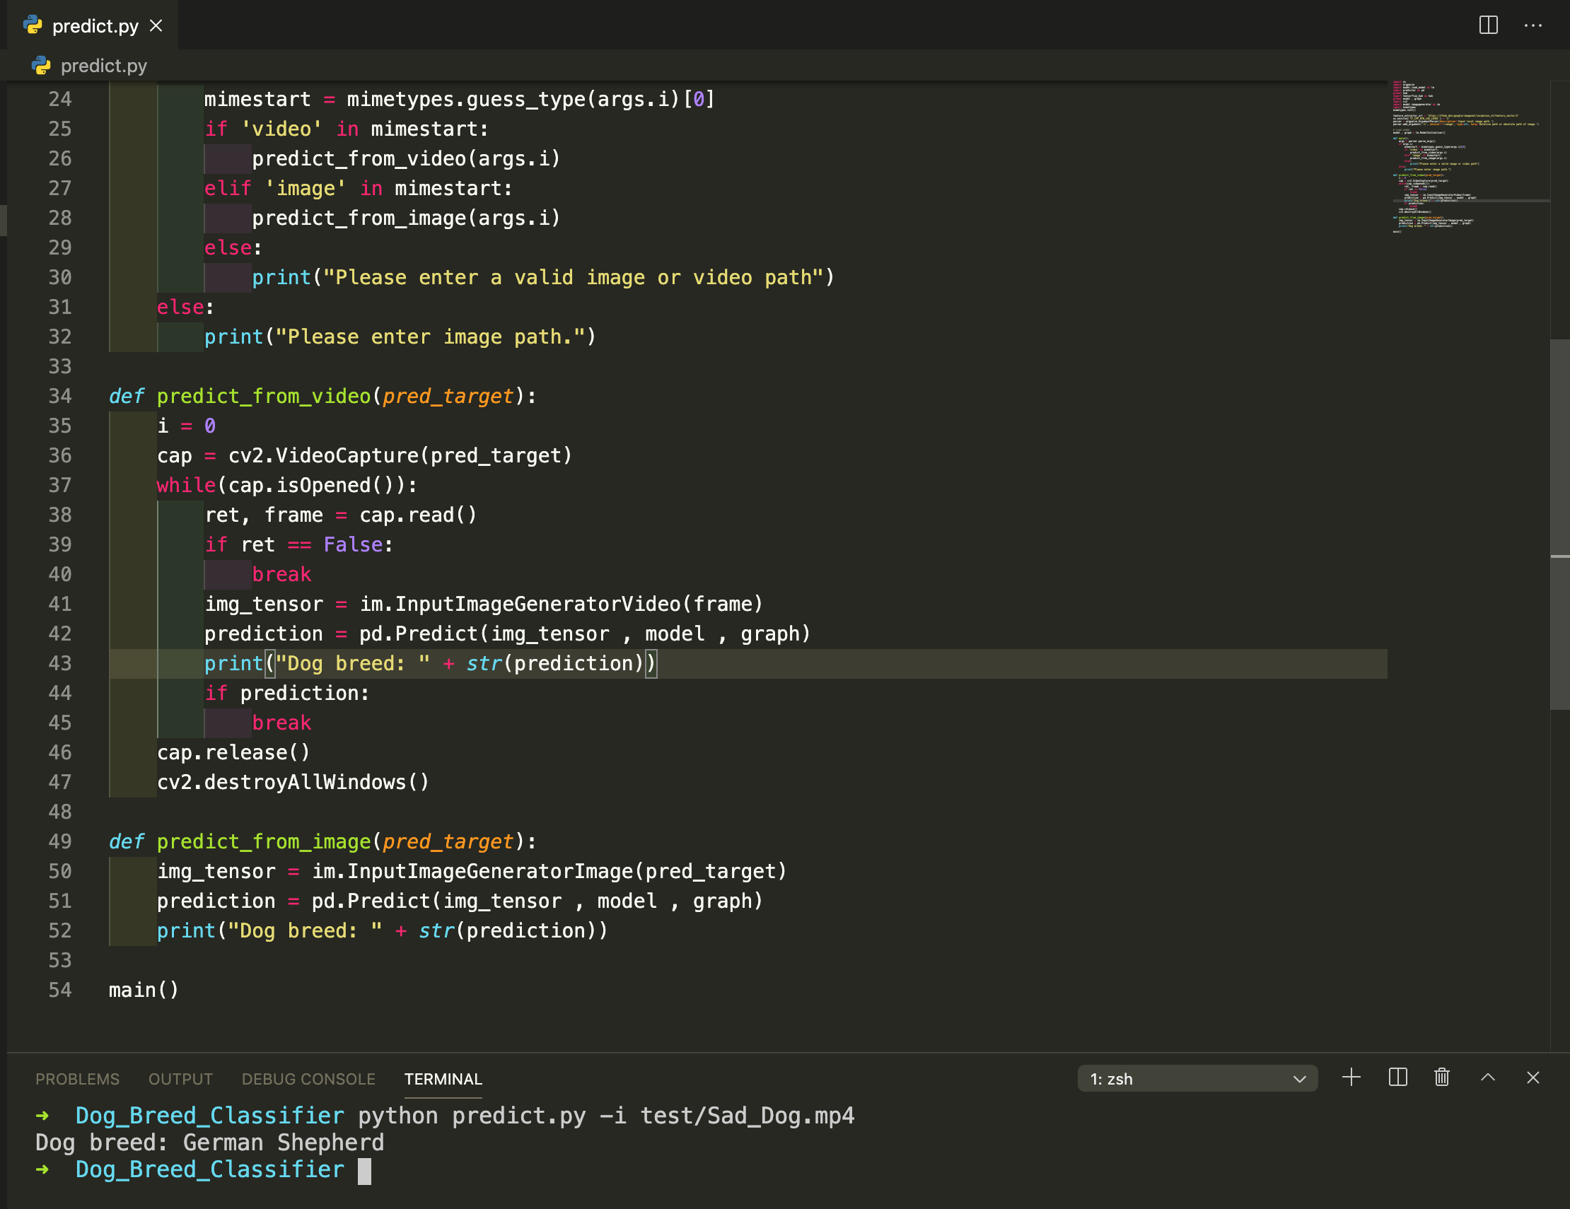
Predicting the correct breed from a video

Slide 17

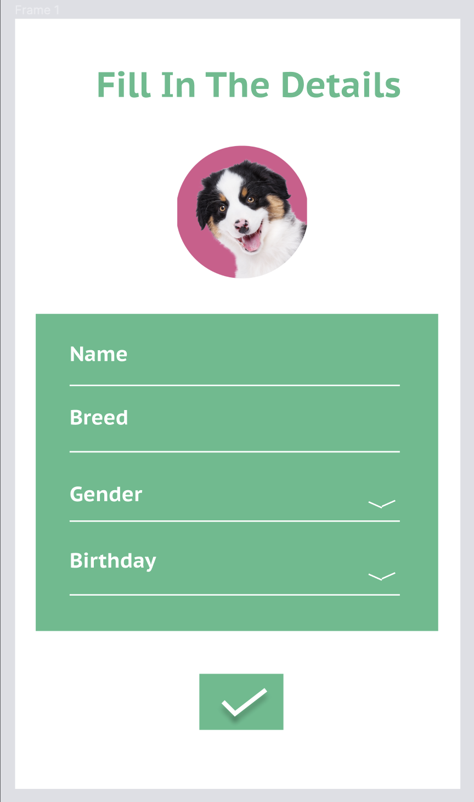
Prototype wireframes.

Slide 18
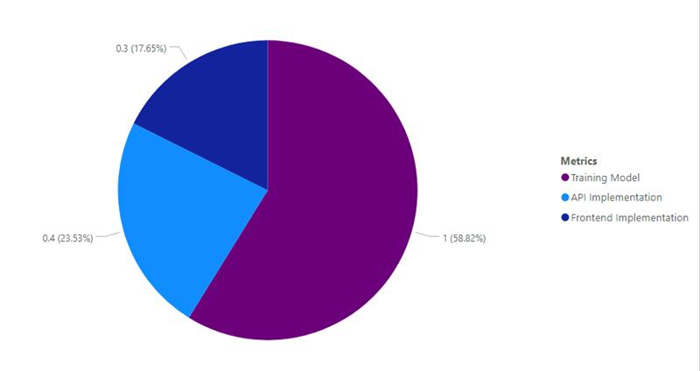
Current Progress
Machine learning Model - 100%
API (DJANGO Framework) - 40%
FrontEnd Implementation - 30%

Slide 19
Future Completion Of Work
Implementation of the API using DJANGO framework.
Implementation of the user interfaces using flutter.
Integrating API with the mobile application.

Slide 20
User Requirements
Functional
Identify the dog breed of the dog in the video or image.
Provide resting time and the activity level of the identified dog breed.
Non - Functional
Accuracy.
Efficiency.

Slide 21
Risk Mitigation.
Less test accuracy obtained when building the CNN from scratch.
Solution - Apply transfer learning for a pretrained CNN.

Slide 22
Walking Pattern Recognition
IT17133678
Boteju W.J.M

Slide 23
Research Problem Definition
So..
A dog moves about here and there all the time..
How do we identify a change in a dog’s walking activity level if it is undergoing a different health condition?

Slide 24
Proof of Concept
Ability to identify dog activity - Walk/ Run
Ability to measure walking activity of the dog using an attached sensor device.
Ability to compare walking and motion activity with average walking activity according to the breed and and analyze the results.
Notify if there is a change in Walking and Motion activity levels.
Ability to view the Motion Duration levels of the dog.

Slide 25
Application of key pillars in specialized area.
Utilization of Wireless communication and smart sensor (MPU 6050) for collection for data for activity recognition.
Application of a machine learning algorithm (Support Vector Machine) for activity recognition using the sensor accelerometer data.
Utilization of a REST framework API to handle multiple types of calls and requests and return data formats.

Slide 26
Application of technologies in the relevant key pillar/ area.
Using the MPU 6050 and NodeMCU to record the activity sensor data.
Using the Arduino IDE to obtain the sensor data with a wireless communication system.
Use of Python language to train the model for Activity Recognition. Python provides extensive set of libraries for machine learning. (sklearn , pandas, joblib , matplotlib)
DJANGO REST framework (Python) to create the API.
Flutter Application for the implementation of the front end.
MongoDB as the database.
Heroku to host the application server.

Slide 27
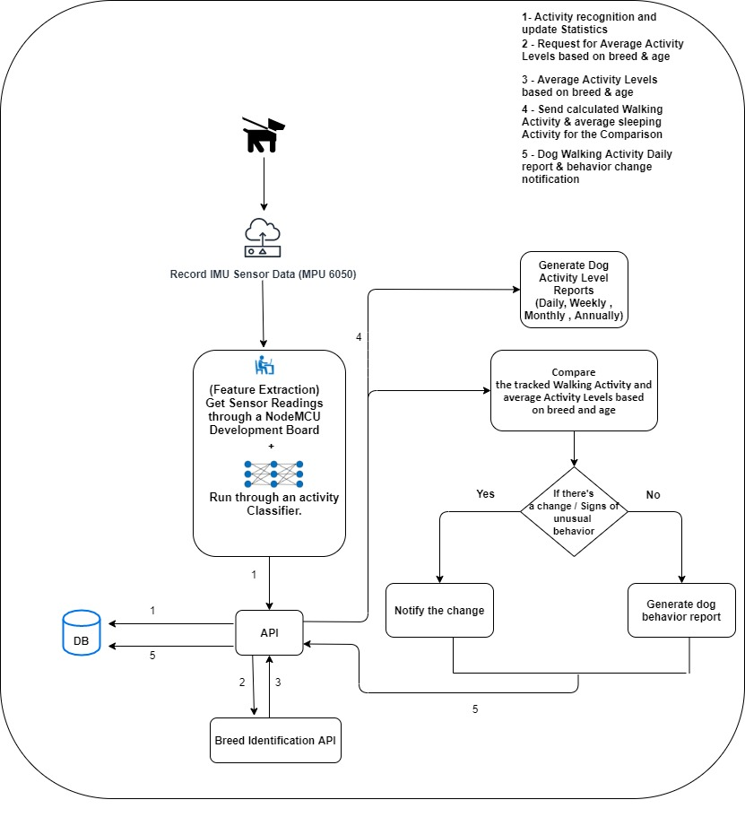

Slide 28
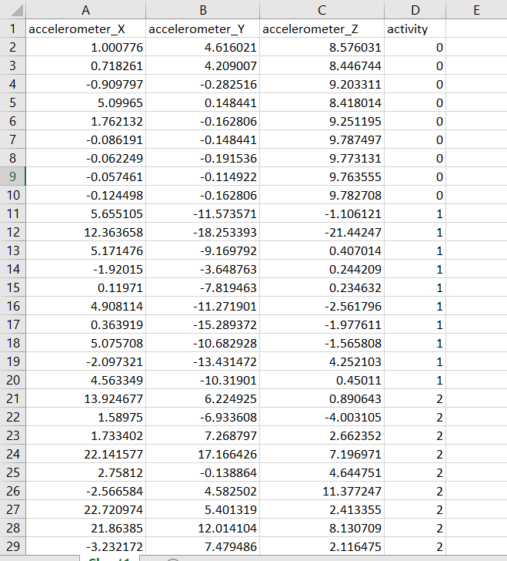
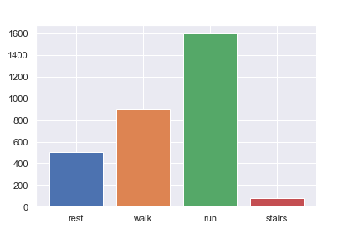
Completion of prototype.
Implementation of a model for activity recognition
Rest - 0 Walk - 1 Run - 2

Slide 29
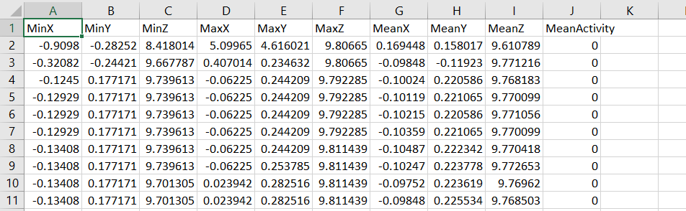
Model Input Data - Created Feature Vector
A feature vector consisting of Mean , Highest Peak , Lowest Peak of the data window is created of the data in 3 axes (x, y ,z).
<Min Peak , Max Peak , Mean>

Slide 30
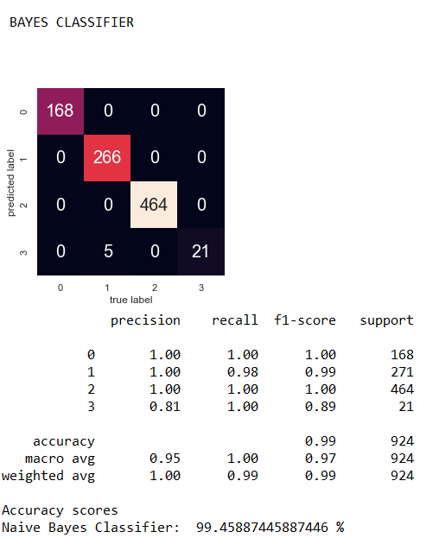
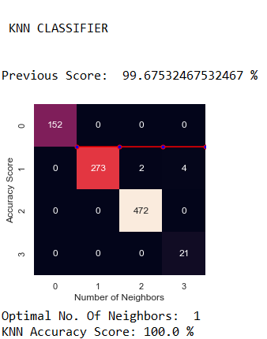
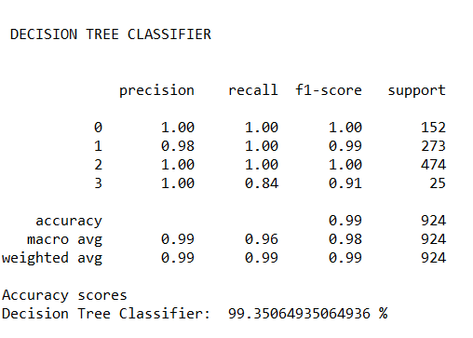
Selection of best algorithm.
The following algorithms were used to train the model and detect the best algorithm for activity recognition.
KNN Classifier (1 neighbour)
Naive Bayes Classifier
Support Vector Machine
Decision Tree Classifier

Slide 31
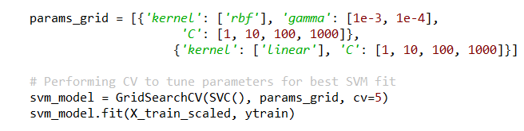
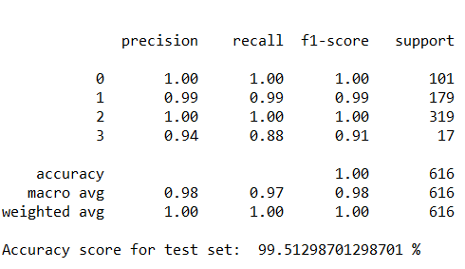
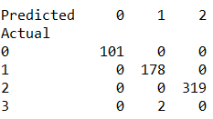
Machine Learning Algorithm used.
Support Vector Machine
Kernel = linear , C= 100, gamma = scale
Accuracy Score - 99.512 %
Activity Prediction
(20% of the dataset)

Slide 32
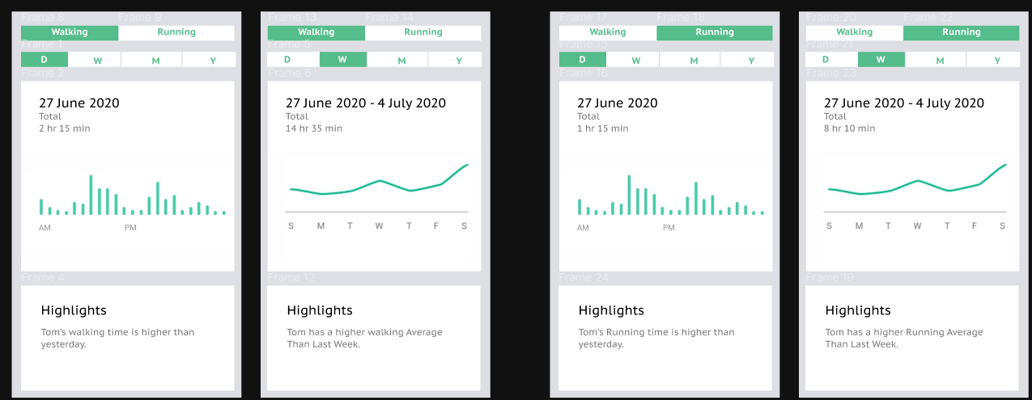
Prototype wireframes - Figma

Slide 33

REST API implementation using DJANGO REST Framework.
Implementation of user interfaces using Flutter integrated with the backend implementations (API service calls).

Slide 34
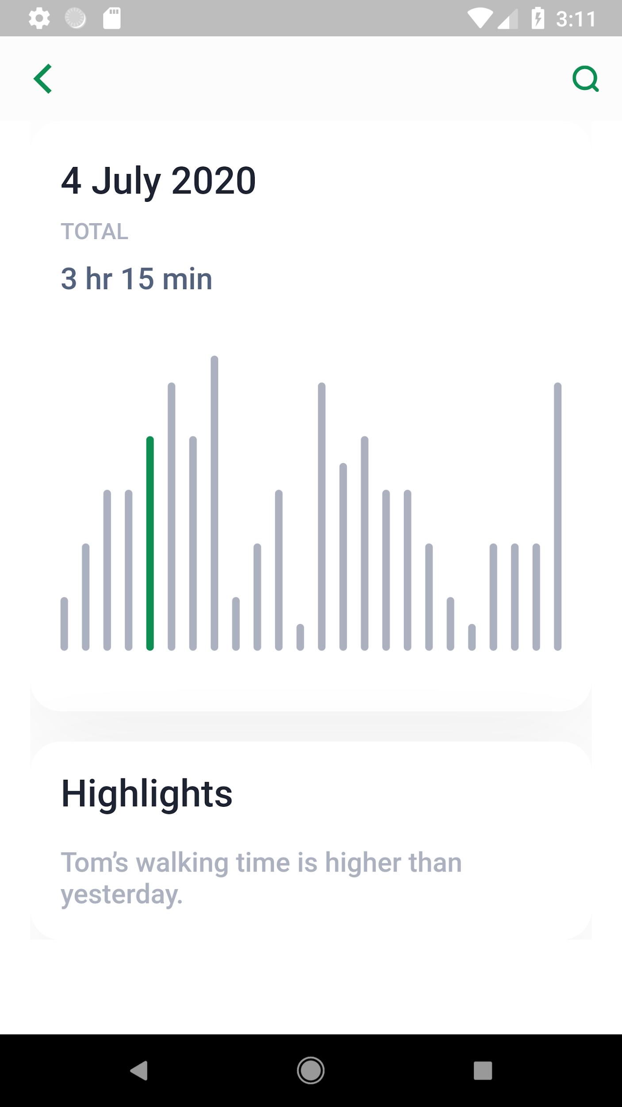
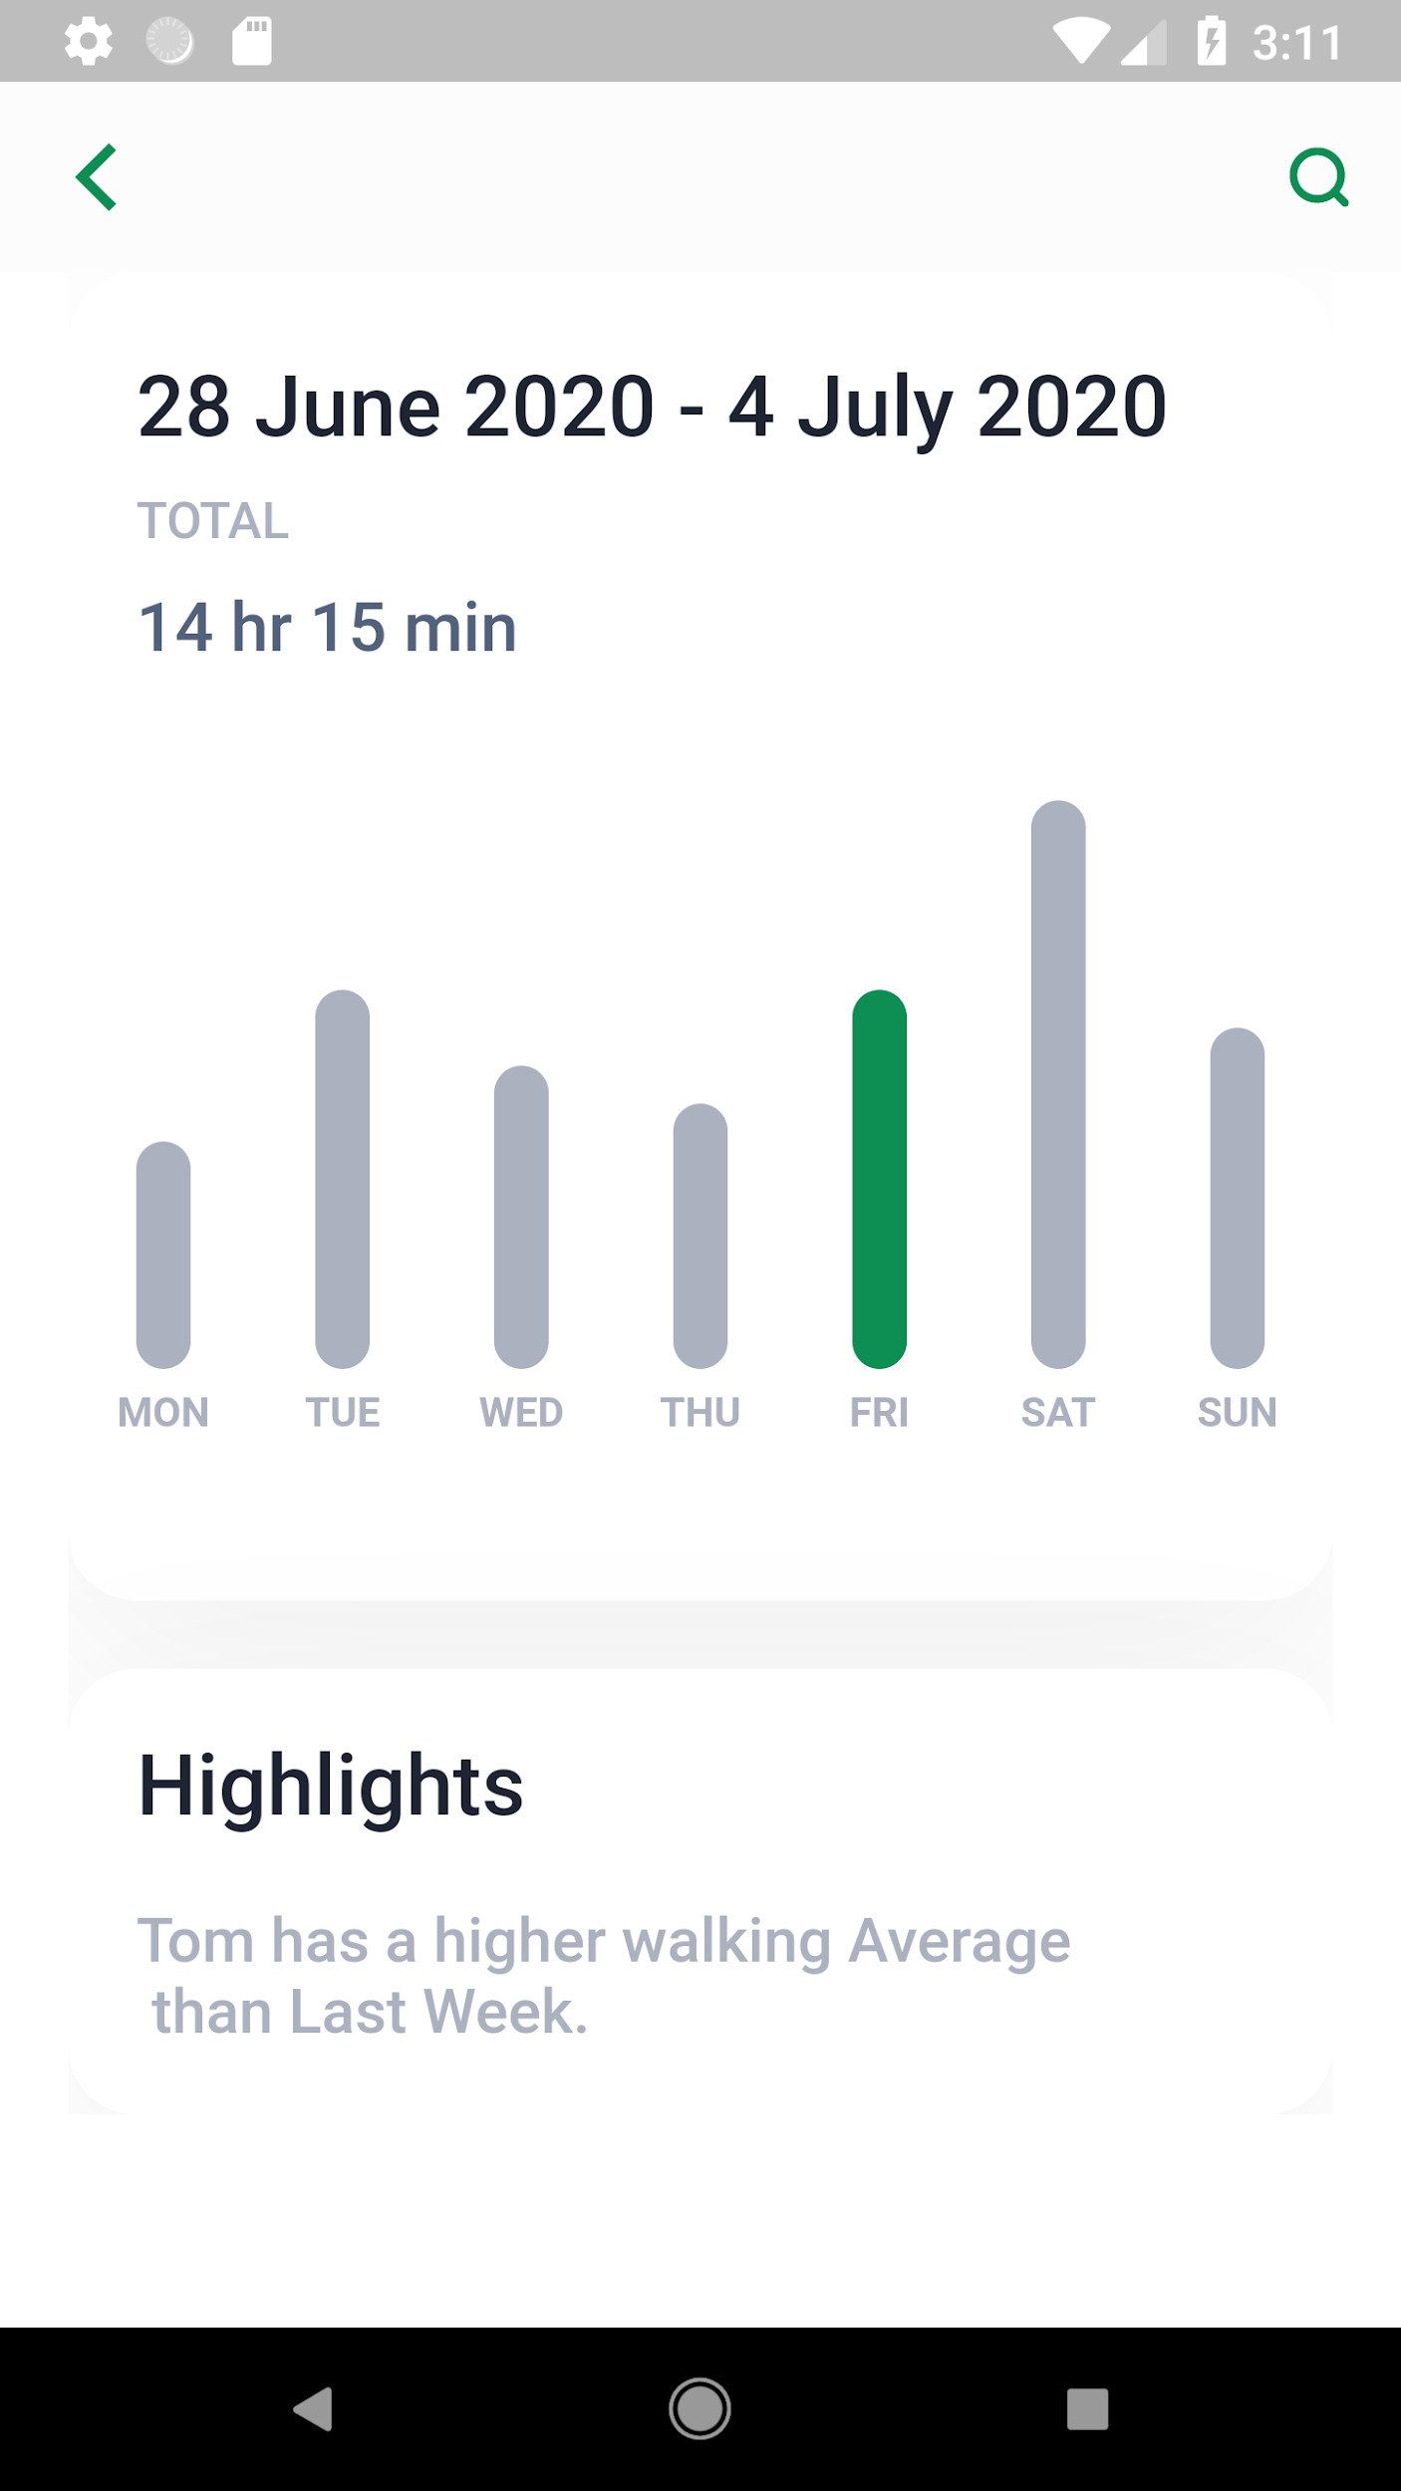
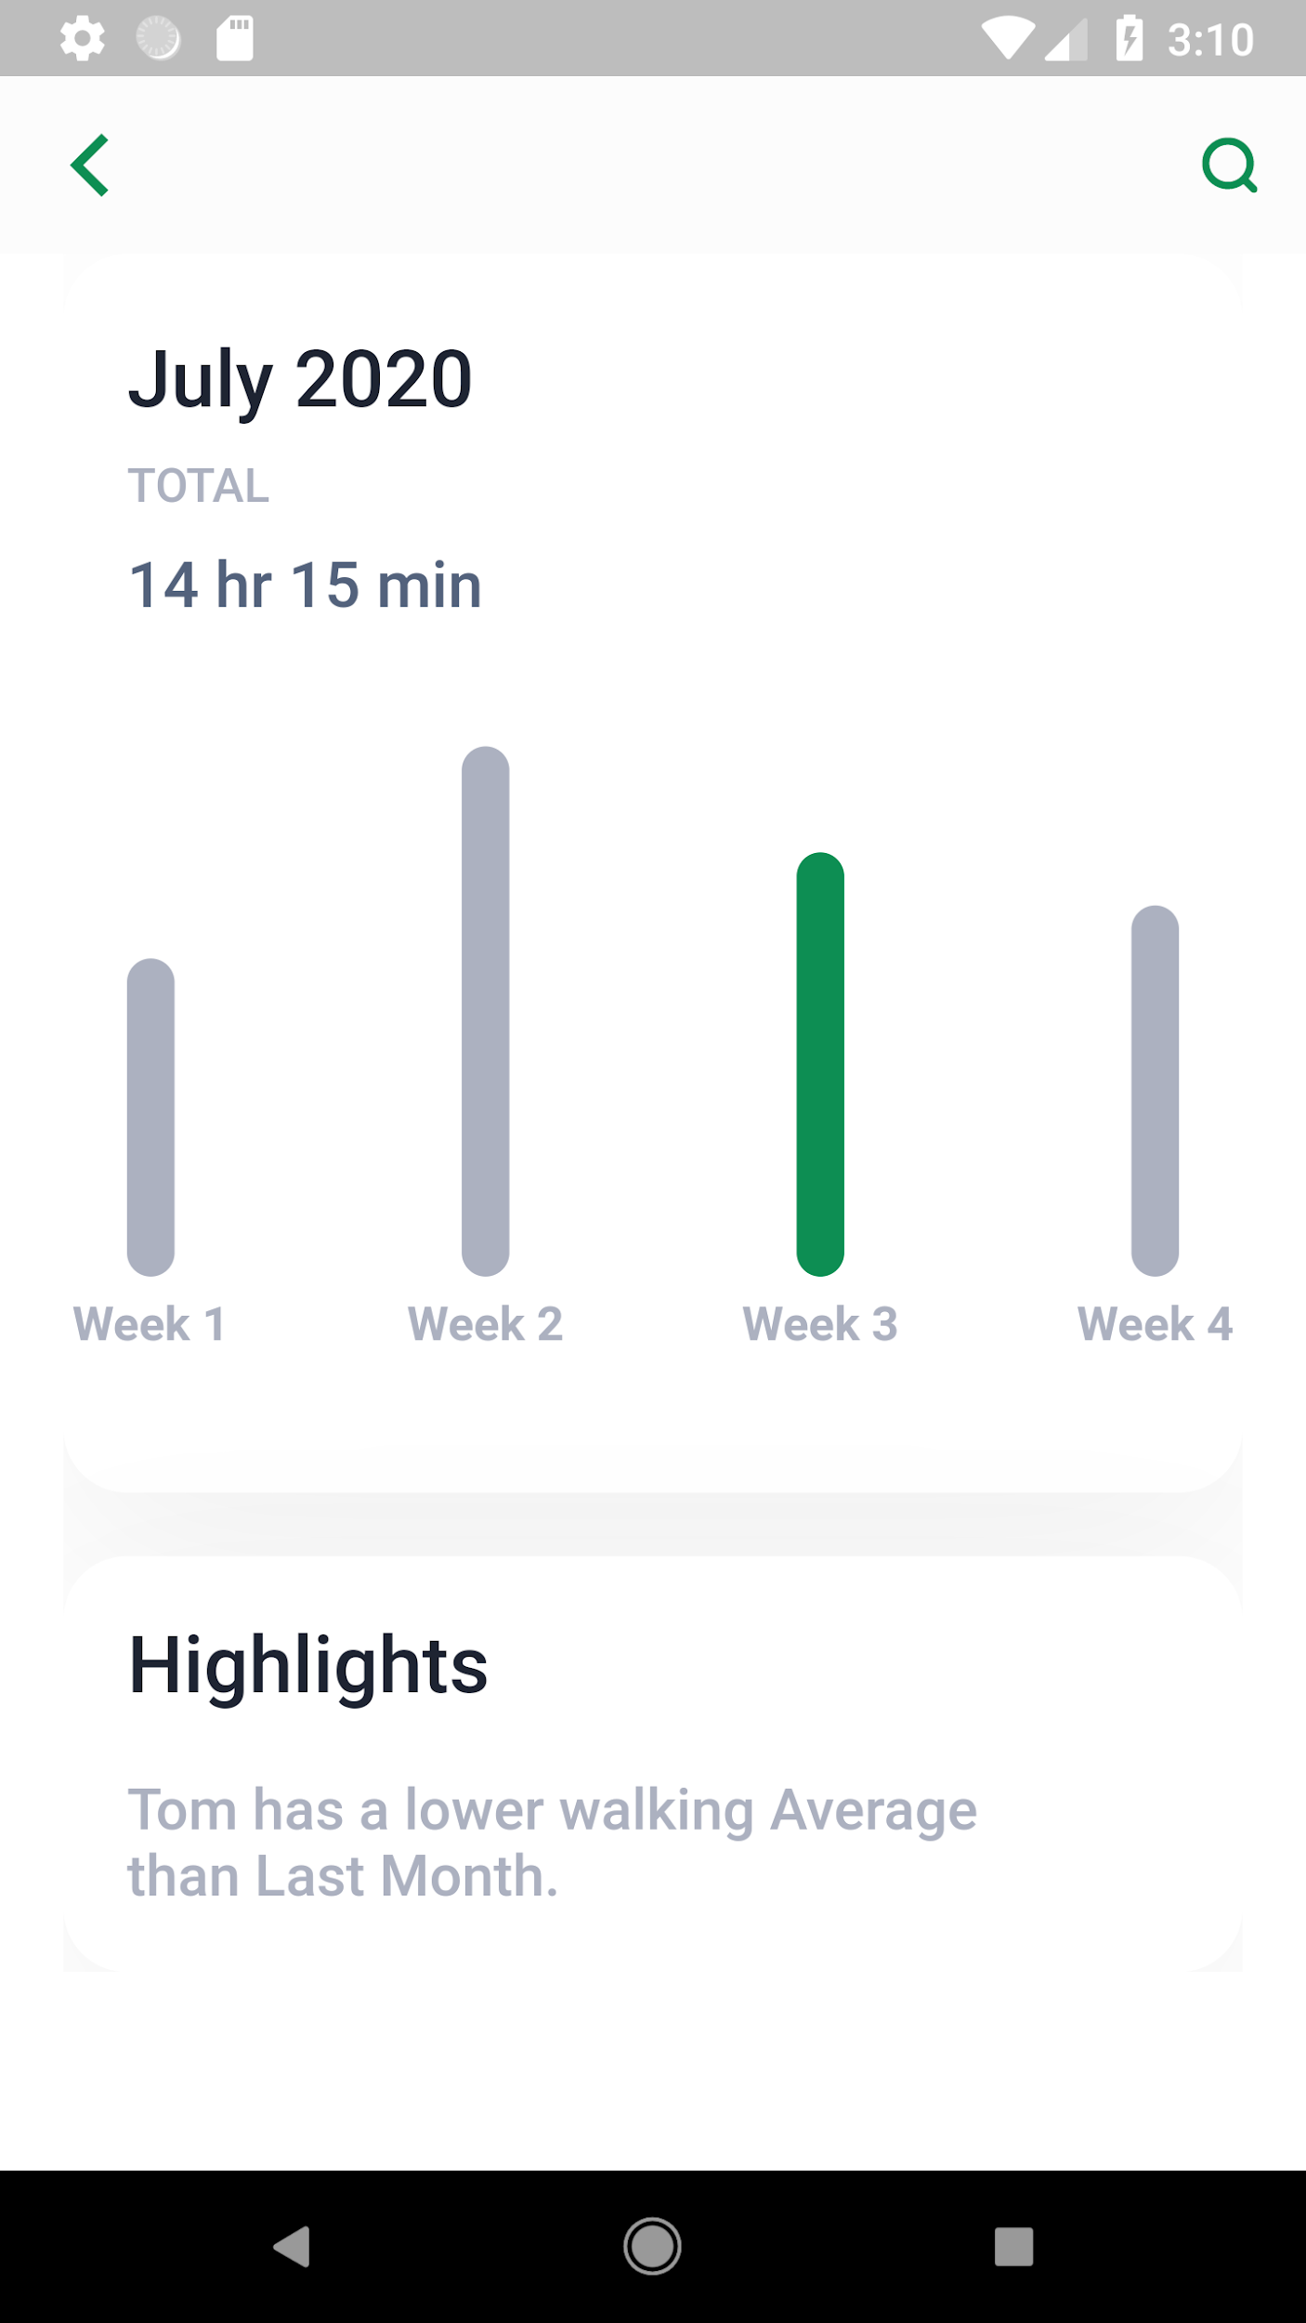
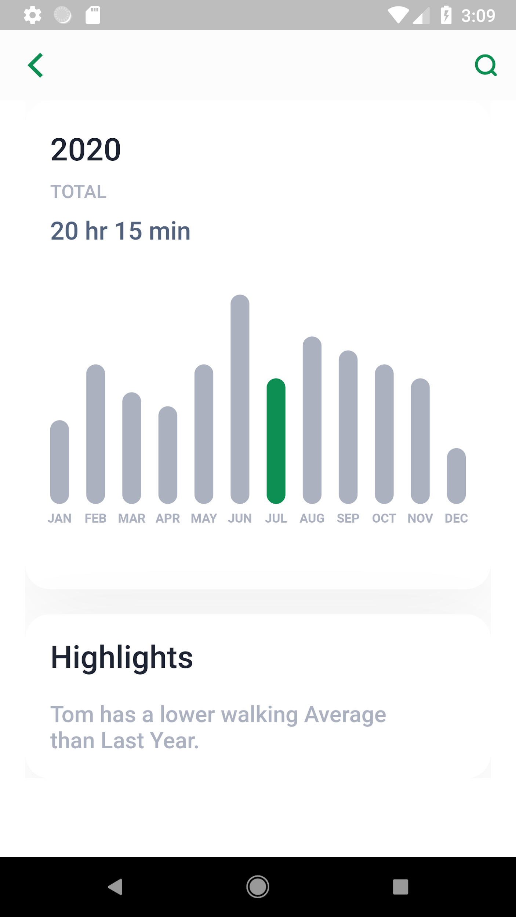

Slide 35
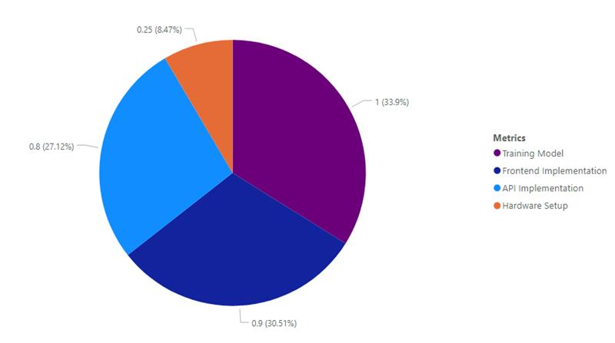
Current Progress
Machine learning Model - 90%
API (Django REST Framework) - 80%
FrontEnd Implementation - 90%
Hardware Setup - 20%
OVERALL PROGRESS - 45 %

Slide 36
Future completion of work.
Implementation of the IMU sensor(MPU6050) and NodeMCU and integration with the Arduino IDE.
Comparison of the activity levels of the dog based on breed and age and notify the user regarding unusual behaviour patterns of the dog.
Remaining backend and frontend implementations for the system for the comparison of activity levels.
Background tasks for the above research component and finalize all the user interfaces along with user authentication.
Prepare simulator endpoints for API service calls.
Admin website for the system.

Slide 37
User Requirements
Functional Requirements
Dog activity recognition (Walk, Run)
Measure the walking activity of the dog using the IMU Sensor.
Notify the user if there is an unusual change in activity levels based on breed and age.
Non-Functional Requirements.
Accuracy
Efficiency

Slide 38
Risk Mitigation.
Inability to implement and integrate the IMU sensor device with the NodeMCU and record data.
Solution - Obtain accelerometer data from a tri-axial accelerometer.
Overfitting of data when training the model.
Solution - Reduction of the size of the feature vector to train the model .
From < Mean, Median , MaxPeak , MinPeak , Variance, Standard Deviation , RMS, Energy, Max Magnitude> To <Mean, Min Peak , Max Peak>

Slide 39
Resting Pattern Recognition
IT17123150
Peiris M.D.P.

Slide 40
Research Problem Definition
How to identify behavioral changes in dog’s resting activity based on their breed and age, using both surveillance camera video feed and sensor data?

Slide 41
Proof of concept
Ability to identify whether the dog is in resting state, using image processing.
Ability to confirm the resting time by comparing video feed data and sensor data.
Ability to compare the confirmed resting activity level with the average resting activity level based on dog’s breed and age.
Ability to notify dog owner, if there are changes in resting activity level.

Slide 42
Application of key pillars in specialized area
Use a convolutional neural network model to detect the dog in the video feed and extend the model to identify the resting state of the dog, using transfer learning.
Create a REST API to handle communication among the model, database and other components.

Slide 43
Application of technology in the relevant key pillar / area
Python language - train the model to detect dog and the resting state of the dog using set of libraries such as matplotlib and pandas
Tensorflow - object detection using keras library
ResNet50 - pretrained transfer learning model
Django framework - create REST API
MongoDB - database storage purposes
Flutter UI framework - UI implementation

Slide 44
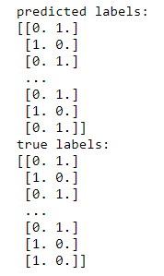

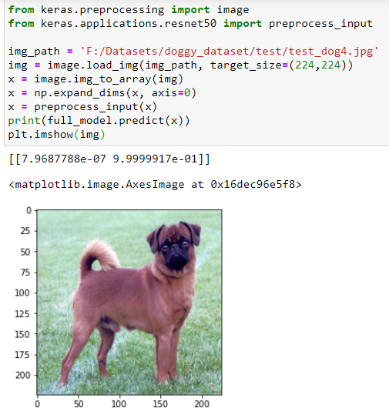
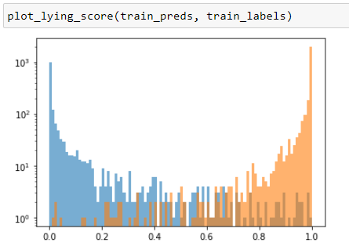
Completion of prototype

Slide 45
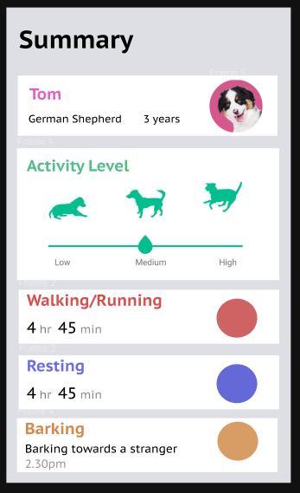
Completion of prototype
REST API implementation, using Django framework.
Wireframes of the mobile app User Interfaces are designed using Figma tool.

Slide 46
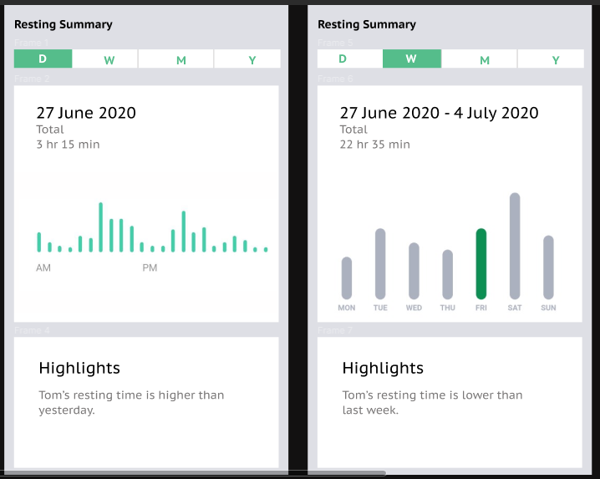

Slide 47
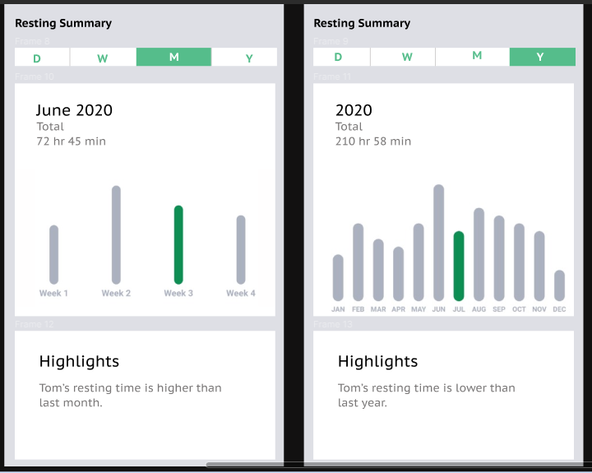

Slide 48
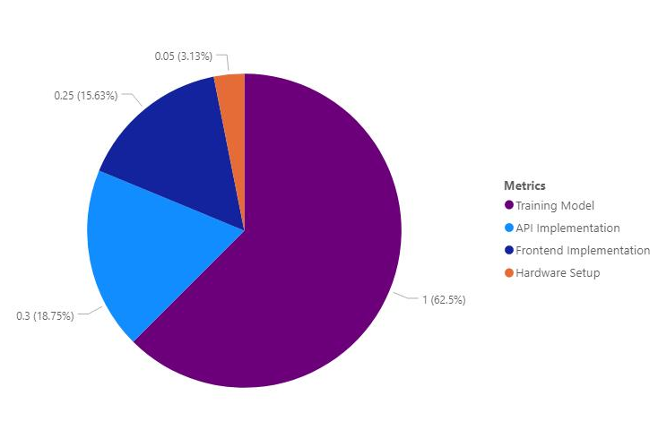
Current Progress
Model Training - 100%
API Implementation - 30%
Frontend Development - 10%
Hardware Setup - 5%

Slide 49
Work yet to be completed
Setting up CCTV camera to the experimental field.
Combine sensor data and video feed data.
Comparisons and identification of resting behavior changes.
UI implementation.

Slide 50
User Requirements
Functional requirements
Find the confirmed resting time period of the dog.
Compare that confirmed resting time with the average resting time of dogs based on their breed and age.
If there is considerable change, notify owner.
Generate resting behavior analysis report daily.
Non-Functional Requirements
Accuracy
Efficiency

Slide 51
Risk Mitigation
Gitlab version controlling - protect the code and keep track of the changes in the implementation.
Planner - schedule tasks and keep track of the dues.
No proper datasets for the training purpose - combination of several datasets.
Transfer learning - train less amount of data using pre-trained model.

Slide 52
Barking Pattern Recognition
IT17141352
A. K. P. Erandi Wathsala

Slide 53
Research Problem Definition
Why do dogs bark????????
Barking when hungry, Barking to stranger, barking when want to go out,when see the owner….
How to identify the reasons for dog barking….
How to track unusual barking behaviors…..
Dog owner has slight ability of understanding the barking.

Slide 54
Proof of Concepts
Ability of extracting barking audio from video footages which comes from a CCTV camera.
Ability of identifying barking behaviors towards different situations.
Ability of identifying unusual behaviors after comparing.
Ability of notifying identified barking patterns as well as unusual barking behaviors.
Ability of generating reports

Slide 55
Application of key pillars in specialized area
Utilization of CCTV camera with the mic to collect to audio data for barking recognition.
Application of machine learning algorithm(Convolutional Neural Network) to identify different barking patterns.
Utilization of REST API to handle multiple types of request and return data from the database.

Slide 56


Application of technologies in the key pillars/ area.
Using a CCTV camera with the mic to record barking audio data.
Using of Python language to extract features and train the model- keras, librosa, matplotlib, pandas, etc...
DJANGO REST Framework (Python) to create the API.
Flutter application for the implementation of the front end.
MongoDB as the database.
Heroku to host the application server.

Slide 57
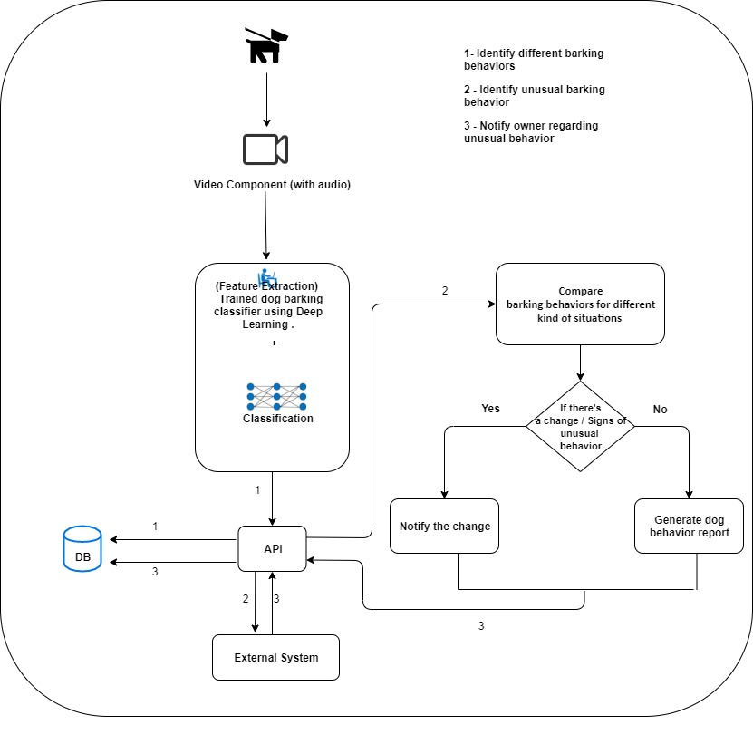
System Diagram

Slide 58
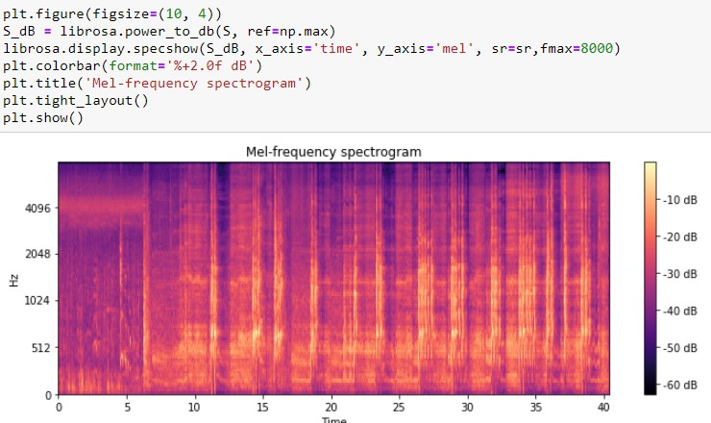
Completion of prototypes

Slide 59
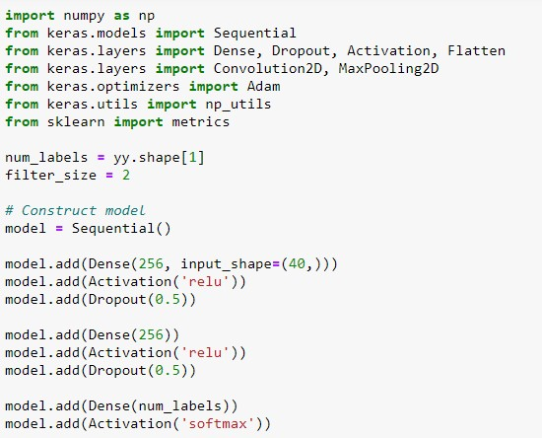
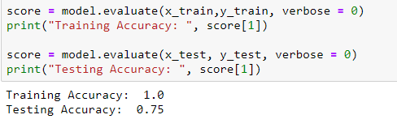
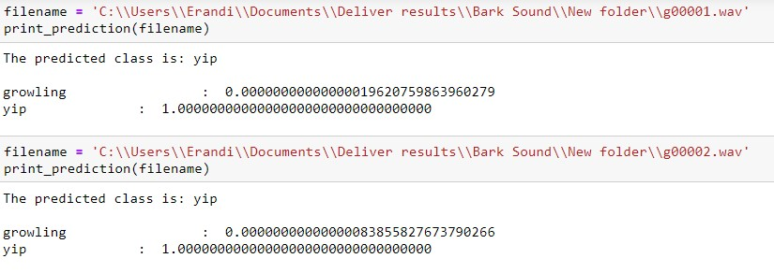

Slide 60
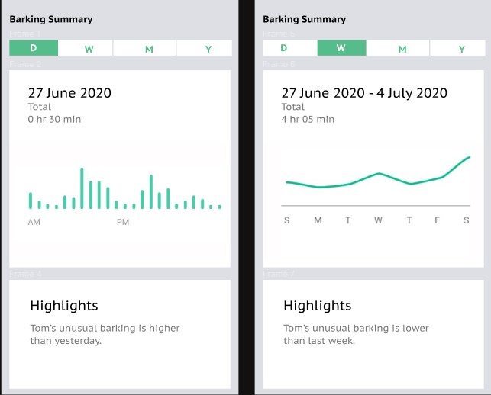

Slide 61
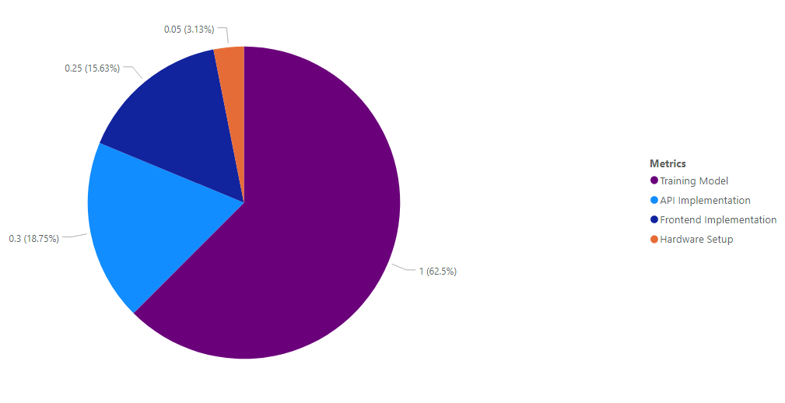
Current Progress
Model Training - 100%
API Implementation - 30%
Frontend Development - 10%
Hardware Setup - 5%

Slide 62
Future completion of work
Implementation of CCTV camera and collect real dog barking data.
Extract features from real barking data and use them to re-train the model and check the accuracy.
Implementation of notifications to notify the user with different barking patterns and unusual barkings.
Backend and frontend implementation.
.Further implementation of REST API.
Integration of the whole system.

Slide 63
User Requirements
Functional Requirements
Dog barking behavior identification for different situations.
Identify unusual barking behaviors.
Notify owner.
Non Functional Requirements
Efficiency
Accuracy
Accessibility

Slide 64
Risk Mitigation
Unavailability of dog barking datasets in different patterns.
Overfitting of data when training the model.
Gitlab version controlling - save every version and recover the code.
Planner - Difficulty of finishing the task as the planned on time.

Slide 65
Ability of commercialization
In Sri Lanka, there are no applications to track the unusual behavioural changes in a dog and identify them.
In Sri Lanka ,there are only GPS trackers , to identify the location of the pet.
This application helps the user to track the history levels of the dog and also identify any unusual Patterns.
Low Cost
We will be using only a basic IMU Sensor and Regular CCTV camera with clear audio recognition to identify the behavioural changes in the dog.
Accuracy and Efficiency-
Daily generated behavioural reports regarding the activity level of the dog.

Slide 66
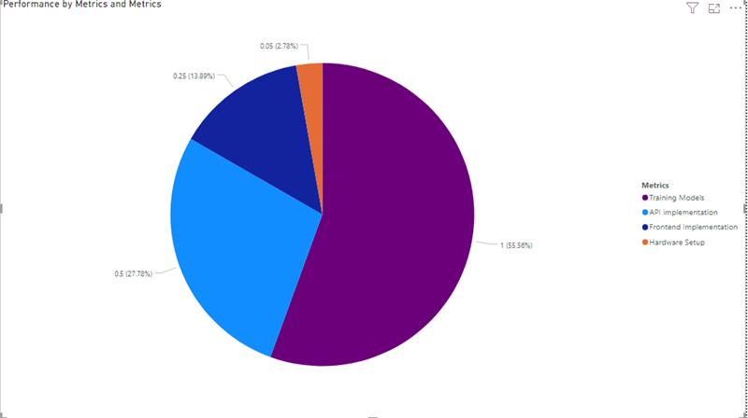
Group Current progress
Machine learning Model - 90%
API (Django REST Framework) - 40%
FrontEnd Implementation - 40%
Hardware Setup - 20%
OVERALL PROGRESS - 45 %

Slide 67
Thankyou !!
Any Questions ??

